Slide 1
Unit 2
Topic 5
Principle of Paragraph writing

Slide 2

Y N I K

Slide 3


STEPS TO FOLLOW
Think “What is the topic sentence for the paragraph” and “What are the main ideas.”
Give one or two details to explain your topic sentences. And you can use examples here.
Write a closing sentence at the end and you can go to the next paragraph.

Slide 4
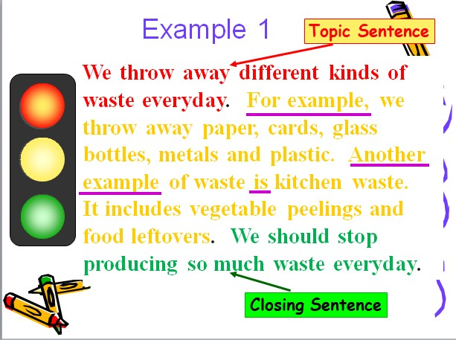

Slide 5
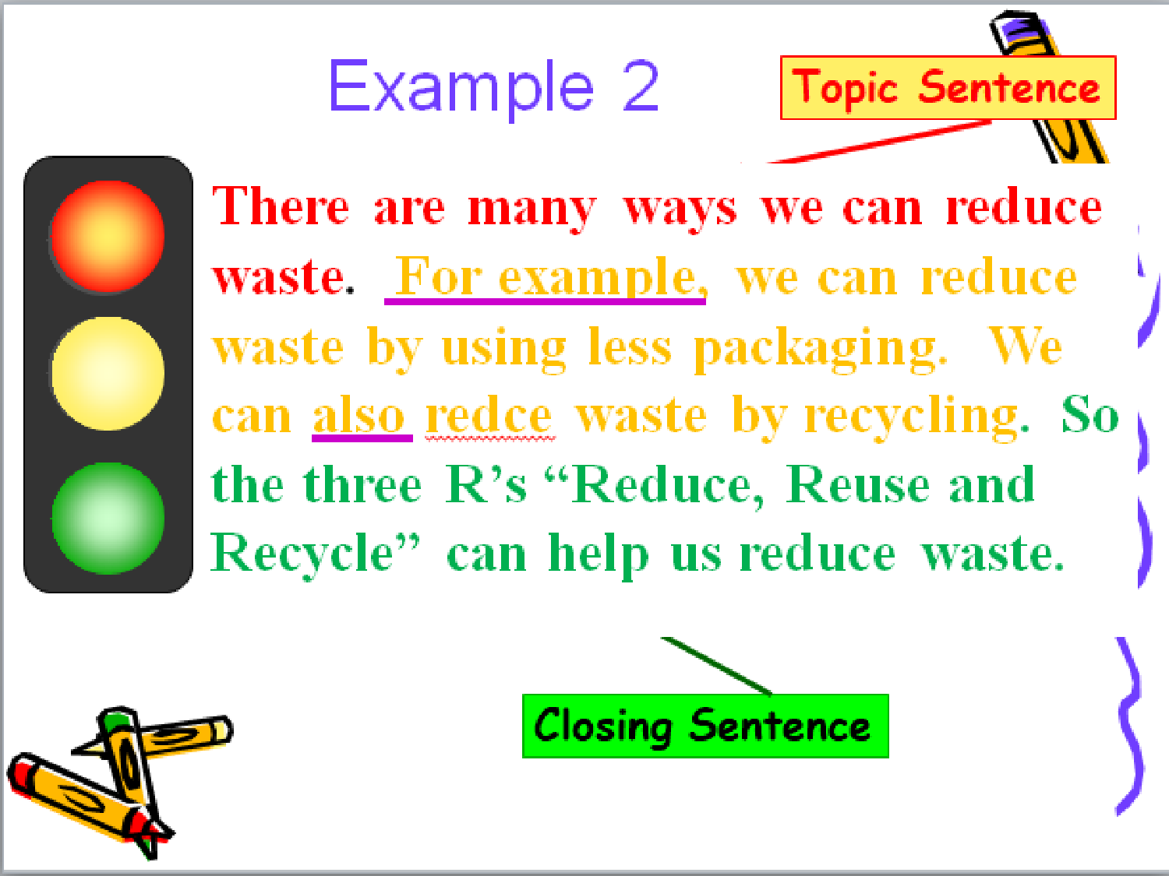

Slide 6
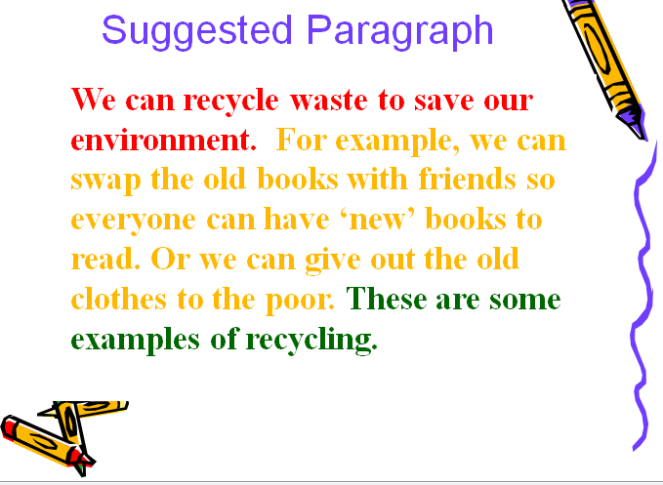

Slide 7
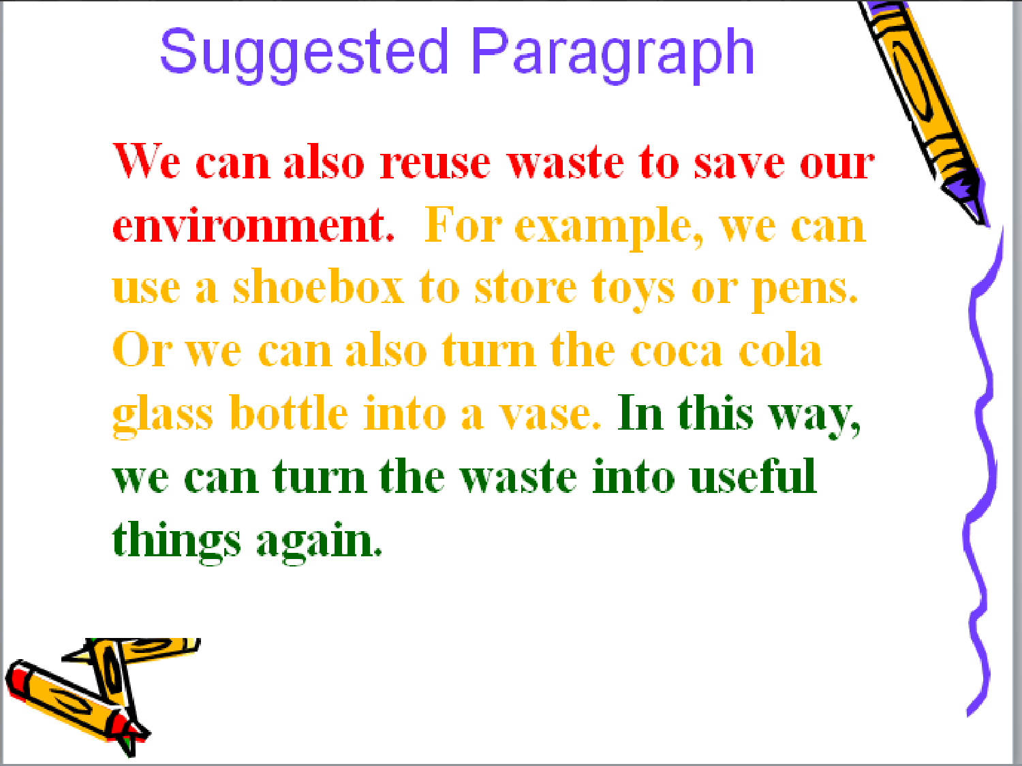

Slide 8
